Slide 1
Deep Unsupervised Learning
Project Descriptions

Slide 2
The project grade counts for 30% of the total grade and it breaks down as follows:
10% Quality of the code.
10% Quality of the report (i.e., clarity of the exposition, significance of the adopted methods, critical analysis of the results, and conclusion).
10% Quality of the oral presentation.
Group of upto 3 students.
Free Gpus: Google Colab / Kaggle

Slide 3
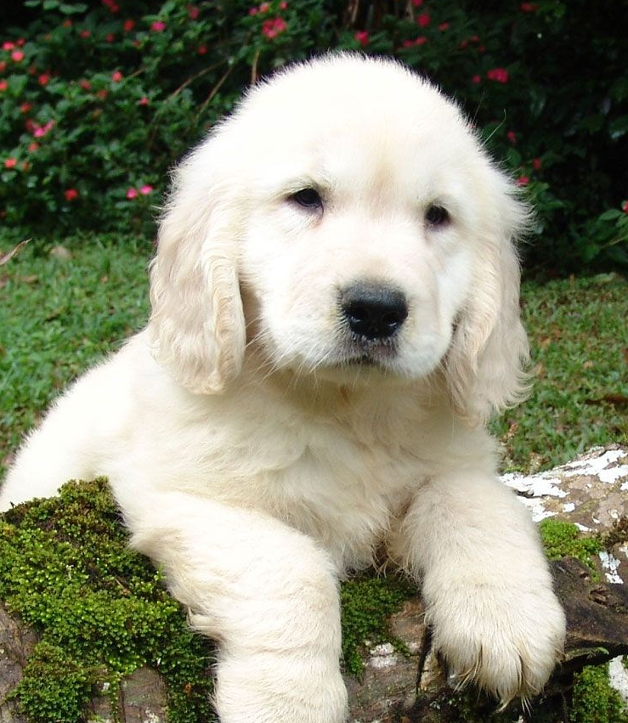
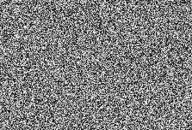
Recommendations
Image generation
Image Inpainting (Conditional image generation)

Slide 4
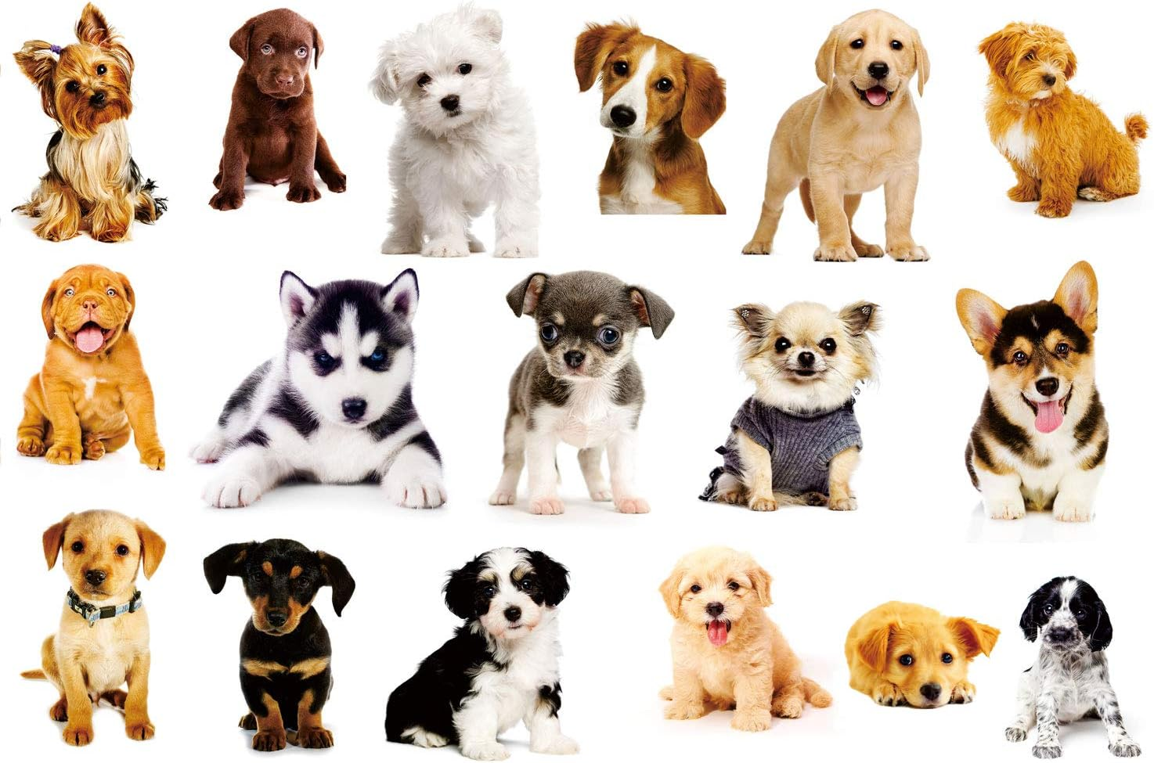
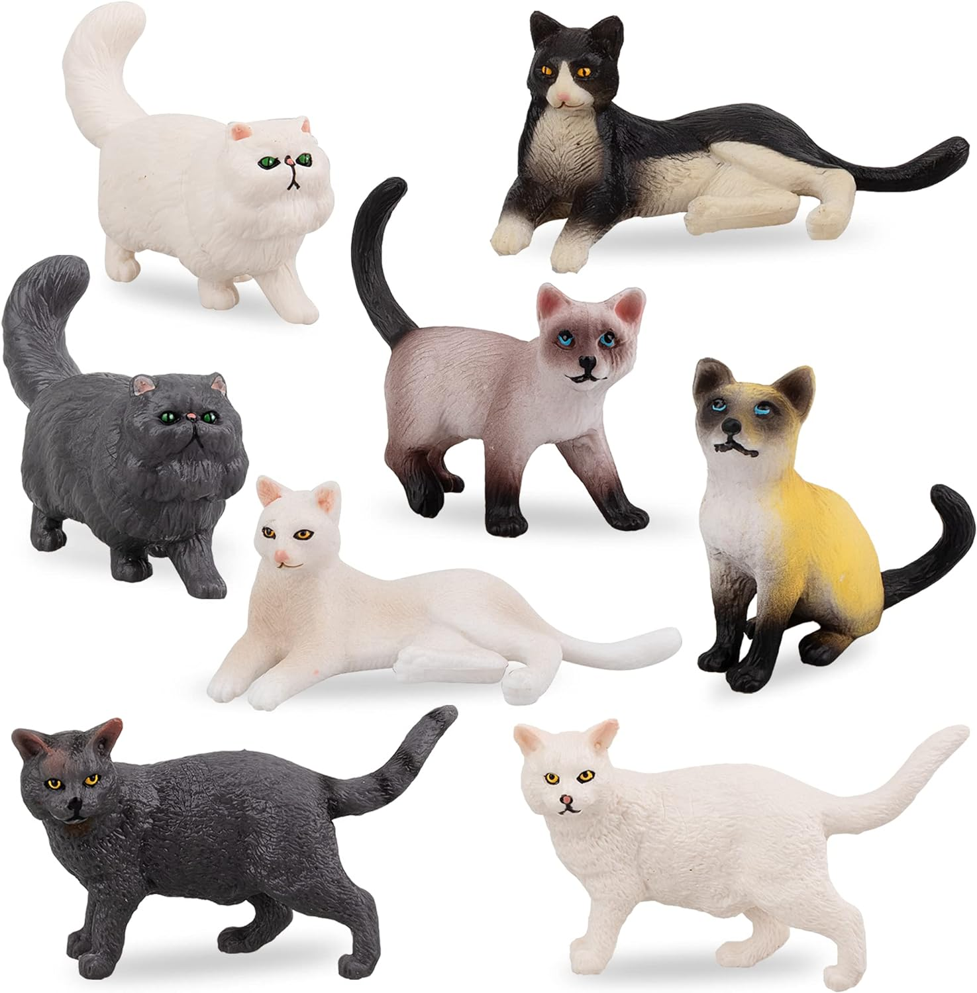
Recommendations
Unsupervised Anomaly detection
Define your own project (after my approval)
Normal
Anomaly

Slide 5
Implementations
You have to implement at least 3 models:
GANs
VAEs
AE/GMM

Slide 6
1. **Image Inpainting with GANs:**
- Implement a GAN-based model for image inpainting using the Fashion MNIST dataset.
- Train the generator to fill in missing parts of images while the discriminator distinguishes between real and generated images.
- Experiment with different loss functions and architectures to improve the inpainting quality.
- Evaluate the model's performance using metrics like PSNR (Peak Signal-to-Noise Ratio) and SSIM (Structural Similarity Index).
2. **Conditional Image Generation with GANs:**
- Extend the basic GAN architecture to a conditional setting where you conditionally generate images based on specific labels or attributes.
- Utilize Fashion MNIST labels (e.g., T-shirt/top, trouser, pullover, etc.) as conditioning information to generate images of specific clothing types.
- Implement techniques like Conditional GANs (CGANs) or Auxiliary Classifier GANs (ACGANs) for conditional image generation.
- Evaluate the model's ability to generate realistic images corresponding to specific labels.
3. **Variational Autoencoder (VAE) for Fashion MNIST:**
- Develop a VAE architecture to learn a latent representation of Fashion MNIST images.
- Train the VAE to generate realistic images while simultaneously learning a continuous and interpretable latent space.
- Implement techniques like β-VAE or InfoVAE to control the disentanglement of latent factors.
- Experiment with different latent space interpolations to explore the learned representation's continuity and diversity.
4. **Conditional Variational Autoencoder (CVAE):**
- Extend the VAE architecture to a conditional setting where you conditionally generate images based on specific labels or attributes.
- Incorporate Fashion MNIST labels as conditional information to generate images of desired clothing types.
- Implement techniques like Conditional VAE (CVAE) or Conditional Variational Autoencoder with Adversarial Learning (CVAE-GAN).
- Evaluate the model's performance in generating realistic and diverse images conditioned on specific labels.
5. **Semi-supervised Learning with VAE-GANs:**
- Combine VAE and GAN architectures to perform semi-supervised learning on the Fashion MNIST dataset.
- Utilize labeled and unlabeled data to simultaneously learn a latent representation and generate realistic images.
- Implement techniques like the Adversarial Variational Bayes (AVB) framework for joint learning with labeled and unlabeled data.
- Evaluate the model's performance in leveraging unlabeled data to improve classification accuracy and image generation quality.
6. **Style Transfer with GANs:**
- Explore style transfer techniques using GAN architectures with the Fashion MNIST dataset.
- Train the model to transfer the style of one fashion category to another while preserving the structure and content.
- Implement techniques like CycleGAN or StarGAN for unsupervised or multi-domain style transfer.
- Evaluate the model's ability to generate stylistically transformed images while maintaining realism and coherence.
These project ideas provide a starting point for leveraging the Fashion MNIST dataset with PyTorch to explore various aspects of deep learning, including image inpainting, conditional image generation, and representation learning. Depending on your interests and expertise, you can further customize these projects or combine different techniques to achieve more advanced results.

Slide 7
1. **Autoencoder-based Image Inpainting:**
- Incorporate an autoencoder architecture for image inpainting alongside the GAN model.
- Train the autoencoder to learn a compact representation of input images and reconstruct them accurately.
- Combine the autoencoder's reconstruction loss with the GAN's adversarial loss to improve the inpainting quality.
- Experiment with different bottleneck sizes and reconstruction loss functions (e.g., MSE, SSIM) to optimize the inpainting process.
2. **Conditional Variational Autoencoder (CVAE) with GMM Prior:**
- Extend the conditional VAE (CVAE) architecture to include a Gaussian Mixture Model (GMM) prior over the latent space.
- Incorporate Fashion MNIST labels as conditional information and model the latent space using a mixture of Gaussian distributions.
- Train the model to generate realistic images conditioned on specific labels while sampling latent variables from the GMM prior.
- Explore techniques like mixture density networks (MDNs) to parameterize the output distribution of the generator conditioned on the latent variables sampled from the GMM prior.
3. **Unsupervised Clustering with GMM:**
- Utilize GMMs for unsupervised clustering of Fashion MNIST images into distinct categories.
- Train the GMM model to learn the underlying distribution of images in the latent space.
- Use the learned GMM to cluster images based on their latent representations.
- Evaluate the clustering performance using metrics like silhouette score or purity and visualize the clusters to understand the learned representations.
4. **Hybrid Model: VAE-GAN with GMM Regularization:**
- Develop a hybrid model that combines VAE-GAN architecture for image generation with GMM regularization.
- Train the VAE-GAN to generate realistic images while learning a latent representation.
- Regularize the latent space using a GMM prior to encourage disentanglement and improve the diversity of generated images.
- Experiment with different regularization strengths and trade-offs between reconstruction, adversarial, and GMM regularization losses.
5. **Style Transfer with AE and GMM:**
- Explore style transfer techniques by incorporating an autoencoder architecture alongside GMM.
- Use the autoencoder to extract content features from input images and GMM to model style distributions.
- Transfer style by matching the style distributions between different fashion categories while preserving content features.
- Experiment with different reconstruction and style loss functions to achieve visually appealing style transfer results.
These additions not only diversify the techniques used but also offer opportunities to explore the synergy between different deep learning approaches such as autoencoders, GANs, VAEs, and Gaussian Mixture Models.

